Slide 1
BASICS
C Language

Slide 2
CONTENTS
Introduction
Syntax, Comments
Keywords
Data Types
Variable Declaration & Initialization
Rules for constructing variable name
Storage Classes

Slide 3
Introduction
C, computer programming language developed in the early 1970s by American computer scientist Dennis M. Ritchie at Bell Laboratories (formerly AT&T Bell Laboratories).
C program is a collection of one or more functions or statements or instructions.
C has
operators - 45
keywords - 32
separators - 14
characters - 256

Slide 4
Characteristics
Every C program must have main() function.
main() indicates the starting of C program and all the statements must be enclosed with in the curly braces.
C is a case-sensitive language.
The main features of the C language include:
General Purpose and Portable
Low-level Memory Access
Fast Speed
Clean Syntax

Slide 5
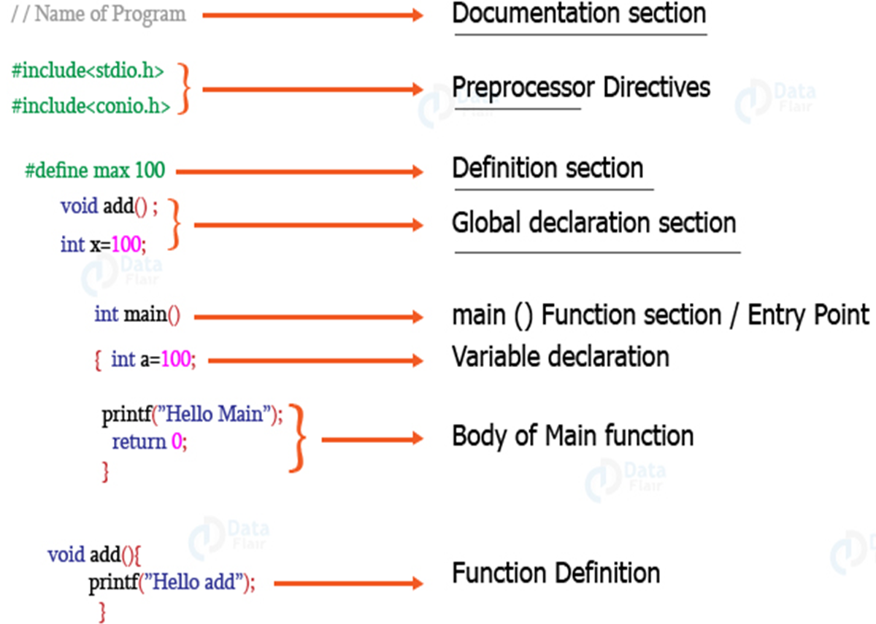
Structure of C Program

Slide 6
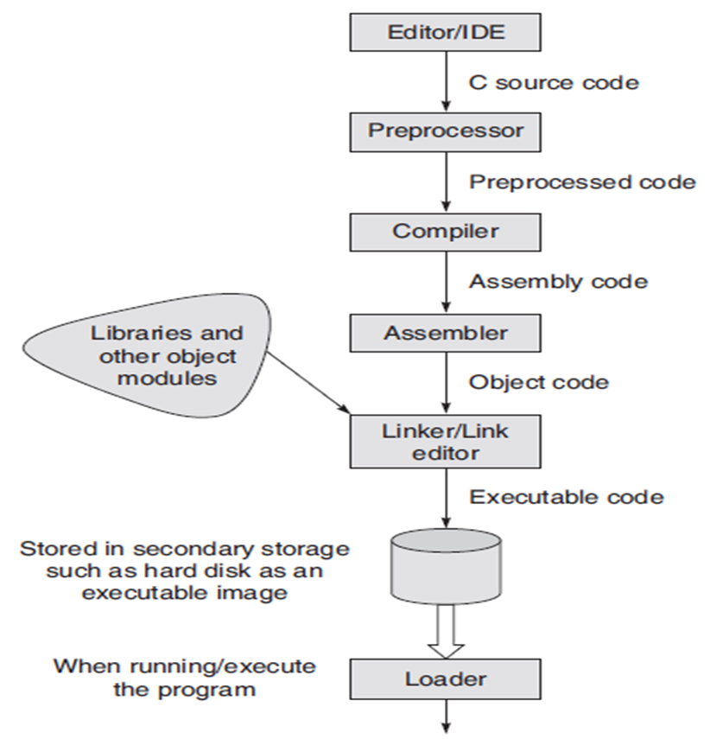
Typical steps for entering, compiling, and executing C programs

Slide 7
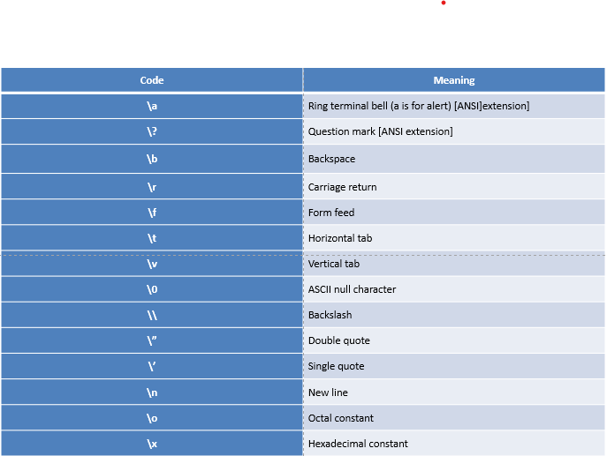
Escape characters

Slide 8
Comments
The comments in C are human-readable explanations or notes in the source code of a C program.
A comment makes the program easier to read and understand.
These are the statements that are not executed by the compiler or an interpreter.
It is considered to be a good practice to document our code using comments.
Types of comments in C
In C there are two types of comments in C language:
Single-line comment //
Multi-line comment /* ....... */
Outputs In Separate Lines - http://tinyurl.com/3zdk47sa

Slide 9
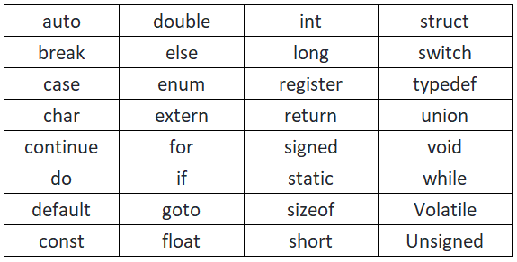
32 Keywords

Slide 10
Data Types
Data types are used -
- Reserve the memory
- what type of operation is to done in future.
So that this particular reserved memory will not be used for other purposes.
Double datatype - http://tinyurl.com/bdsskb5k

Slide 11
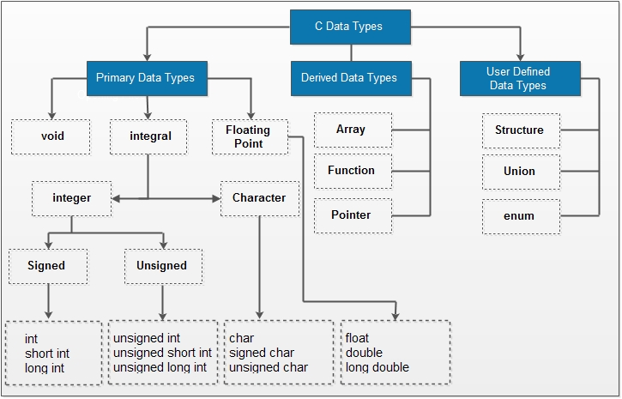

Slide 12
Variable
A variable in C is a memory location with some name that helps store some form of data and retrieves it when required. We can store different types of data in the variable and reuse the same variable for storing some other data any number of times.
data_type variable_name = value; // defining single variable
or
data_type variable_name1, variable_name2; // defining multiple variable
Ex: int var = 1011;
Declaring a variable - http://tinyurl.com/mrxynjrp
Declaration & Initialization

Slide 13
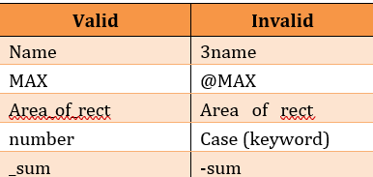
Rules for constructing variable name
They should start with an alphabet but not any other character except underscore.
It should not start with a digit.
C is case sensitive
It should not be a keyword.
Whitespace between the variable name is not allowed, means identifier should be a single word, but to join the words we can use underscore (_).

Slide 14
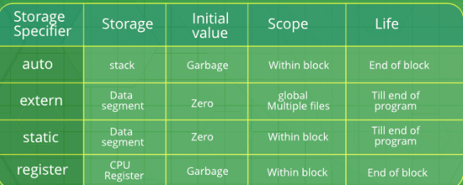
Storage Classes

Slide 15
OPERATORS
C Language

Slide 16
LIST OF OPERATORS
Arithmetic Operators
Unary Arithmetic Operators
Relational Operators
Assignment Operators
Logical Operators
Bitwise Operators
Conditional Operators
Special Operators

Slide 17
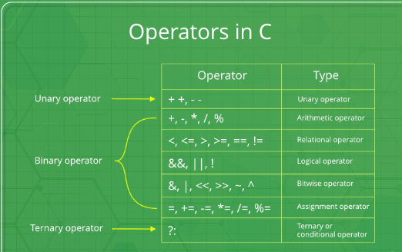

Slide 18
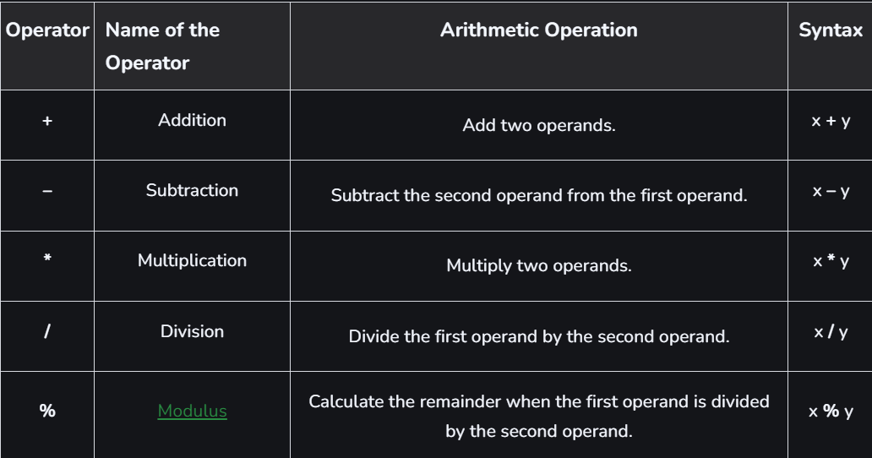
Arithmetic Operators

Slide 19
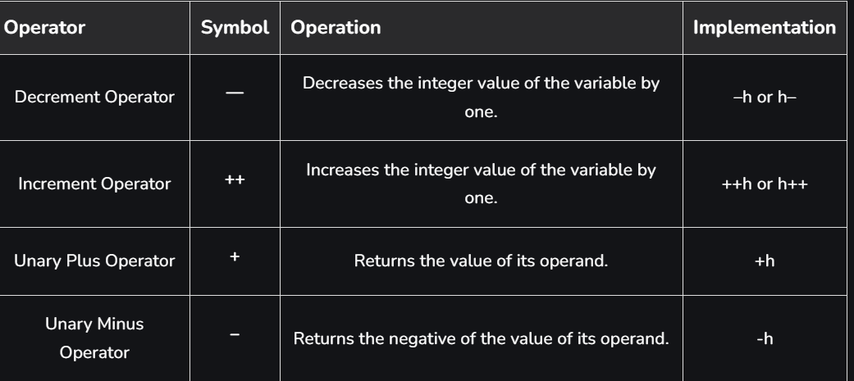
Unary Arithmetic Operators

Slide 20
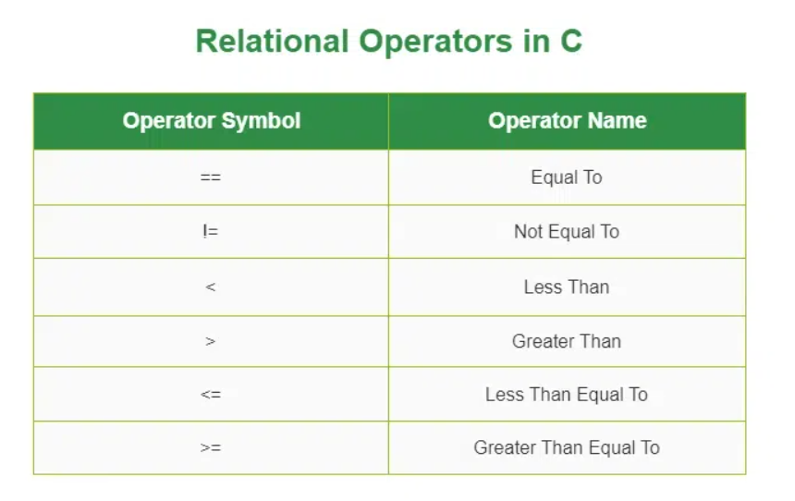

Slide 21
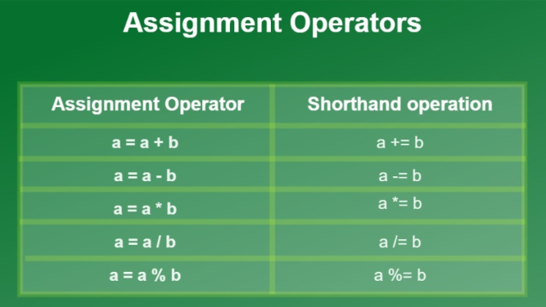

Slide 22
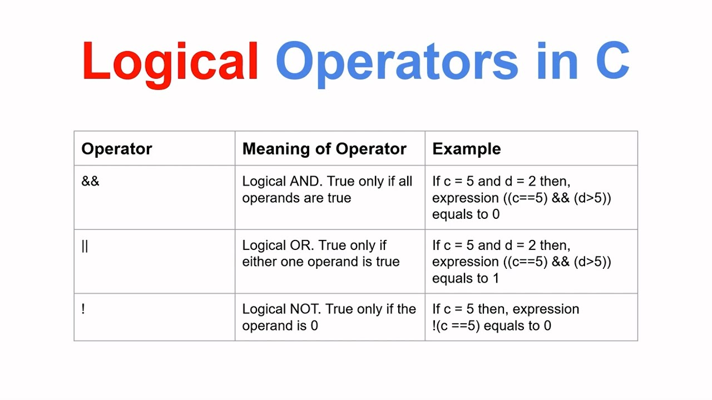

Slide 23
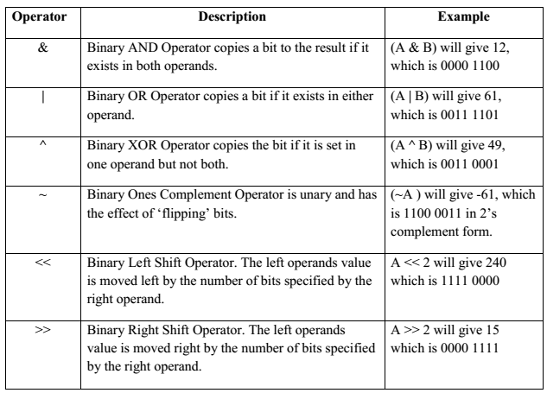
Bitwise Operators

Slide 24
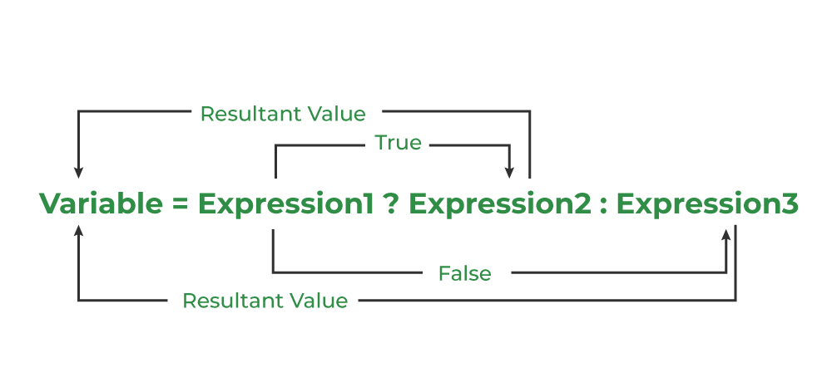
Conditional Operators

Slide 25
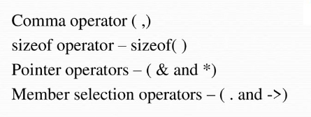
Special Operators

Slide 26
Problems on Operators
Addition of Variables - http://tinyurl.com/yckd2xn4
Area of Rectangle - http://tinyurl.com/e4ss6m9c
Chef and Instant Noodles - http://tinyurl.com/2wh3yb92
CodeChef Learn Problem Solving - http://tinyurl.com/4xyyje5h
Fitness - http://tinyurl.com/y7b92axy
Chef and Chocolates - http://tinyurl.com/2rpy98jm
Arithmetic operators - http://tinyurl.com/mrx3ch6t
Logical Operators - http://tinyurl.com/498k7dhh
Assignment Operators - http://tinyurl.com/578shxkf
Relation Operators - http://tinyurl.com/mu4jur5h

Slide 27
Problems on Operators
Make Avg - http://tinyurl.com/3533jjfs
Math - http://tinyurl.com/2hpua4dd
Candy Store - http://tinyurl.com/5ks8mmer
Problems - http://tinyurl.com/mpwrs6mt
Scalene Triangle - http://tinyurl.com/mezuu5v3
Favorite Numbers - http://tinyurl.com/yekrup5u
7 Rings - http://tinyurl.com/mvscbhjc
Problem (Make Avg) - Solve sub-components - http://tinyurl.com/met9by5z

Slide 28
NUMBER LOGIC
C Language

Slide 29
Concept
For finding the digit count
Division Operator(/) – it returns the quotient.
Modulus Operator(%) – it returns the remainder.

Slide 30
Basic Programs
Count the digits in a number.- http://tinyurl.com/bdfzz6xv
Reverse of a number. - http://tinyurl.com/5dxe6k8t
Palindrome of a number. - http://tinyurl.com/ytvauyyx
Print all divisors. - http://tinyurl.com/bdfs62c6
Armstrong number. - http://tinyurl.com/yj6f6fjb
Prime number. - http://tinyurl.com/3c8mata2
GCD or HCF - http://tinyurl.com/yu9tf5ra

Slide 31
Reverse of a number
Method-I
#include <stdio.h>
int main() {
int n ;printf("Enter a number\n");
scanf("%d",&n);
int x = n;
int count = 0;
while (x != 0) {
x = x / 10;
count++;
}
printf("Number of digits in %d is %d\n", n, count);
return 0;
}

Slide 32
Method-II
#include <stdio.h>
#include <math.h>
int main() {
int n;
printf("Enter a number\n"); scanf("%d",&n);
int digits = floor(log10(n) + 1);
printf("Number of digits in %d is %d\n", n, digits);
return 0;
}

Slide 33
Method-III
#include<stdio.h>
int main()
{
int N;
printf("Enter a number\n");
scanf("%d",&N);
int num = N;
int reverse = 0;
while(N!=0)
{
int digit = N%10;
reverse = reverse*10+digit;
N = N/10;
}
printf("The reverse of the %d is %d",num,reverse);
}

Slide 34
Palindrome number
#include <stdio.h>
int main() {
int X;
printf("Enter a number\n");
scanf("%d",&X);
int dummy = X;
int Y = 0;
while (X > 0) {
int digit = X % 10;
Y = Y * 10 + digit;
X = X / 10;
}
if (dummy == Y) {
printf("Palindrome Number\n");
} else {
printf("Not Palindrome Number\n"); }
return 0;
}

Slide 35
Print divisors
BruteForce Approach:-
#include <stdio.h>
int main() {
int n;
printf("Enter a number\n"); scanf("%d",&n);
printf("The Divisors of %d are:\n", n);
for (int i = 1; i <= n; i++) {
if (n % i == 0) {
printf("%d ", i);
}
}
printf("\n");
return 0;
}

Slide 36
Optimal Approach:-
#include <stdio.h>
#include <math.h>
int main() {
int n; printf("Enter a number\n");
scanf("%d",&n);
printf("The Divisors of %d are:\n", n);
for (int i = 1; i <= sqrt(n); i++) {
if (n % i == 0) {
printf("%d ", i);
if (i != n / i) {
printf("%d ", n / i);
}} }
printf("\n");
return 0;
}

Slide 37
Armstrong number- https:/tests.mettl.com/authenticateKey/92437794
#include <stdio.h>
#include <math.h>
int main() {
int n1 = 153, originalno = n1, count = 0, temp = n1;
while (temp != 0) {
count++;
temp = temp / 10; }
int sumofpower = 0; int n = n1;
while (n != 0) {
int digit = n % 10;
sumofpower += pow(digit, count);
n /= 10;
}
if (sumofpower == originalno) {
printf("Yes, it is an Armstrong Number\n");
} else {
printf("No, it is not an Armstrong Number\n"); }
return 0;
}

Slide 38
Prime number
BruteForce Approach:-
#include <stdio.h>
int main() {
int n; printf("Enter a number\n"); scanf("%d",&n);
int isPrime = 1;
if (n <= 1) {
isPrime = 0;
} else {
for (int i = 2; i < n; i++) {
if (n % i == 0) {
isPrime = 0;
break;
} } }
if (isPrime == 1) {
printf("Prime Number\n");
} else {
printf("Non Prime Number\n");
}
return 0;
}

Slide 39
Optimal Approach:-
#include <stdio.h>
#include <math.h>
int main() {
int n;
printf("Enter a number\n");
scanf("%d",&n);
int isPrime = 1;
if (n <= 1) {
isPrime = 0;
} else {
for (int i = 2; i <= sqrt(n); i++) {
if (n % i == 0) {
isPrime = 0;
break;
}
}
}
if (isPrime == 1) {
printf("Prime Number\n");
} else {
printf("Non Prime Number\n");
}
return 0;
}

Slide 40
GCD
Bruteforce approach:-
#include <stdio.h>
int main() {
int num1 = 4, num2 = 8;
int ans;
for (int i = 1; i <= (num1 < num2 ? num1 : num2); i++) {
if (num1 % i == 0 && num2 % i == 0) {
ans = i;
}
}
printf("The GCD of the two numbers is %d\n", ans);
return 0;
}

Slide 41
Optimal approach:-
#include <stdio.h>
int main() {
int a = 4, b = 8;
while (b != 0) {
int temp = b;
b = a % b;
a = temp;
}
printf("The GCD of the two numbers is %d\n", a);
return 0;
}

Slide 42
CONDITIONAL STATEMENTS
C Language

Slide 43
C If Statement
Syntax :
if(test expression)
{
// code
}
How If Statement Works?
The if statement evaluates the test expression inside the parenthesis
If the test expression evaluates to true the body of if is executed
if the test expression evaluates to false the body of if is not executed

Slide 44
Program to display a number if it is negative
#include <stdio.h>
int main() {
int number;
scanf("%d", &number);
if (number < 0) {
printf("You entered %d\n", number);
}
printf("The if statement is easy.");
return 0;
}

Slide 45
if...else Statement - http://tinyurl.com/mtn89x3s
Syntax
if(test expression)
{
// code
}
else {
// code
}
How if…else statement works?
If the test expression is evaluated to true, statements inside the body of if are executed, statements inside the body of else are skipped from execution.
If the test expression is evaluated to false, statements inside the body of else are executed, statements inside the body of if are skipped from execution.

Slide 46
Check whether an integer is odd or even
#include <stdio.h>
int main() {
int number;
printf("Enter an integer: ");
scanf("%d", &number);
if (number%2 == 0) {
printf("%d is an even integer.",number);
}
else {
printf("%d is an odd integer.",number);
}
return 0;
}

Slide 47
C if...else Ladder
Syntax:
if (condition1) {
// block of code to be executed if condition1 is true
} else if (condition2) {
// block of code to be executed if the condition1 is false and condition2 is true
} else {
// block of code to be executed if the condition1 is false and condition2 is false
}
The if...else ladder allows us to check between multiple test expressions

Slide 48
Program To Relate 2 Numbers
#include <stdio.h>
int main() {
int number1, number2;
scanf("%d %d", &number1, &number2);
if(number1 == number2) {
printf(“Numbers are equal");
}
else if (number1 > number2) {
printf(“Number1 is greater than Number2");
}
else {
printf(“Number2 is greater than Number1”);
}
return 0;
}

Slide 49
C Switch
Instead of writing many if..else statements, you can use the switch statement.
The switch statement selects one of many code blocks to be executed
Syntax:
switch (expression) {
case x:
// code block
break;
case y:
// code block
break;
default:
// code block
}

Slide 50
Example Program:
#include <stdio.h>
int main() {
int day = 2;
switch (day) {
case 1:
printf("Monday");
break;
case 2:
printf("Tuesday");
break;
case 3:
printf("Thursday");
break;
}
return 0;
}

Slide 51
Problems
Parentheses - http://tinyurl.com/477yphz2
If Statement - http://tinyurl.com/yh4b6nbx
Else If Statement - http://tinyurl.com/prray64d
Else Statement - http://tinyurl.com/y228yy5e
Practice - http://tinyurl.com/73ku9sbh

Slide 52
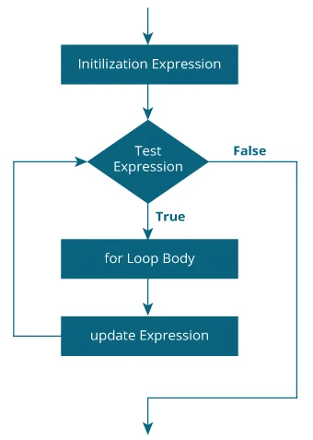
C For Loop
When you know exactly how many times you want to loop through a block of code, use the for loop.

Slide 53
Print numbers from 1 to 10
#include <stdio.h>
int main() {
int i;
for (i = 1; i < 11; ++i)
{
printf("%d ", i);
}
return 0;
}

Slide 54
C While Loop
Syntax :
while (condition) {
// code block to be executed
}
How while loop works?
The while loop evaluates the testExpression inside the parentheses ().
If testExpression is true, statements inside the body of while loop are executed. Then, testExpression is evaluated again.
The process goes on until testExpression is evaluated to false.
If testExpression is false, the loop terminates (ends).

Slide 55
Example Program:
#include <stdio.h>
int main() {
int i = 0;
while (i < 5) {
printf("%d\n", i);
i++;
}
return 0;
}

Slide 56
C do…while loop
The do..while loop is similar to the while loop with one important difference. The body of do...while loop is executed at least once. Only then, the test expression is evaluated.
The syntax is:
do {
// the body of the loop
}
while (testExpression);

Slide 57
Example Program:
#include <stdio.h>
int main() {
int i = 0;
do {
printf("%d\n", i);
i++;
}
while (i < 5);
return 0;
}

Slide 58
C Break and Continue
The break statement ends the loop immediately when it is encountered.
Its syntax is:
break;
The break statement is almost always used with if...else statement inside the loop.
The continue statement skips the current iteration of the loop and continues with the next iteration.
Its syntax is:
continue;
The continue statement is almost always used with the if...else statement.

Slide 59
Example Program Using Break:
#include <stdio.h>
int main() {
int i;
for (i = 0; i < 10; i++) {
if (i == 4) {
break;
}
printf("%d\n", i);
}
return 0;
}

Slide 60
Example Program using Continue :
#include <stdio.h>
int main() {
int i;
for (i = 0; i < 10; i++) {
if (i == 4) {
continue;
}
printf("%d\n", i);
}
return 0;
}

Slide 61
Sum of first 10 natural numbers - http://tinyurl.com/3mxh56w6
display n terms of natural numbers and their sum - http://tinyurl.com/2fmt9vve
find 10 numbers sum and average - http://tinyurl.com/3dhhrtk5
Natural numbers - http://tinyurl.com/4rzcta9w
Print whether it is positive, negative or zero - http://tinyurl.com/2p5sbhck
Print ODD & EVEN numbers
Print all numbers backwards from 100 to 0
Sum of last digits of two given numbers
Greater value of the two numbers - http://tinyurl.com/a2t2bcev
Print all numbers from 1 to 100 - http://tinyurl.com/yckr9fvw
Print whether their sum is EVEN or ODD

Slide 62
FUNCTIONS
C Language

Slide 63
Functions
In c, we can divide a large program into the basic building blocks known as function.
The function contains the set of programming statements enclosed by {}.
A function can be called multiple times to provide reusability and modularity to the C program.
In other words, we can say that the collection of functions creates a program. The function is also known as procedure or subroutine in other programming languages

Slide 64
Advantage of functions in C
By using functions, we can avoid rewriting same logic/code again and again in a program.
We can call C functions any number of times in a program and from any place in a program.
We can track a large C program easily when it is divided into multiple functions.
Reusability is the main achievement of C functions.
However, Function calling is always a overhead in a C program.

Slide 65
Function Aspects
Function declaration :A function must be declared globally in a c program to tell the compiler about the function name, function parameters, and return type.
return_type function_name (argument list);
Function call :Function can be called from anywhere in the program. The parameter list must not differ in function calling and function declaration. We must pass the same number of functions as it is declared in the function declaration.
function_name (argument_list)

Slide 66
Function definition :It contains the actual statements which are to be executed. It is the most important aspect to which the control comes when the function is called. Here, we must notice that only one value can be returned from the function
return_type function_name (argument list) {function body;}
Function Prototypes :Function prototype is also called function signature defines the header of a function declaration:
return-value-type function-name( parameter-list );

Slide 67
A prototype functions is only used when its implementation comes after the main function.
The syntax of creating function in c language is given below:
return_type function_name(data_type parameter...)
{
//code to be executed
}

Slide 68
Types of Functions
There are two types of functions in C programming:
1. Library Functions: are the functions which are declared in the C header files such as scanf(), printf(), gets(), puts(), ceil(), floor() etc.
2. User-defined functions: are the functions which are created by the C programmer, so that he/she can use it many times. It reduces the complexity of a big program and optimizes the code.
Return Value: A C function may or may not return a value from the function. If you don't have to return any value from the function, use void for the return type.

Slide 69
Example without return value:
void hello(){
printf("hello c");
}
Example with return value:
Eg1:
int get(){
return 10;
}
Eg2:
float get(){
return 10.2;
}

Slide 70
Different aspects of function calling
A function may or may not accept any argument. It may or may not return any value. Based on these facts, There are four different aspects of function calls.
function without arguments and without return value
function without arguments and with return value
function with arguments and without return value
function with arguments and with return value

Slide 71
Example for Function without argument and return value
Example 1
#include
void printName();
void main ()
{
printf("Hello ");
printName();
}
void printName() 9.
{
printf("SCRIET");
}
Output: Hello SCRIET

Slide 72
Example 2
#include
void sum();
void main() {
printf("\nGoing to calculate the sum of two numbers:");
sum(); }
void sum() {
int a,b;
printf("\nEnter two numbers");
scanf("%d %d",&a,&b);
printf("The sum is %d",a+b);
}
Output
Going to calculate the sum of two numbers:
Enter two numbers 10 24
The sum is 34

Slide 73
Example for Function without argument and with return value
#include
int sum();
void main() {
int result;
printf("\nGoing to calculate the sum of two numbers:");
result = sum();
printf("%d",result); }
int sum() {
int a,b;
printf("\nEnter two numbers");
scanf("%d %d",&a,&b);
return a+b;
}
Output
Going to calculate the sum of two numbers:
Enter two numbers 10 24
The sum is 34

Slide 74
Example 2:
program to calculate the average of five numbers.
#include
void average(int, int, int, int, int);
void main() {
int a,b,c,d,e;
printf("\nGoing to calculate the average of five numbers:");
printf("\nEnter five numbers:");
scanf("%d %d %d %d %d",&a,&b,&c,&d,&e);
average(a,b,c,d,e); }
void average(int a, int b, int c, int d, int e) {
float avg;
avg = (a+b+c+d+e)/5;
printf("The average of given five numbers : %f",avg);
}
Output
Going to calculate the average of five numbers:
Enter five numbers:10 20 30 40 50
The average of given five numbers : 30.000000

Slide 75
Example for Function with argument and with return value
#include
int sum(int, int);
void main() {
int a,b,result;
printf("\nGoing to calculate the sum of two numbers:");
printf("\nEnter two numbers:");
scanf("%d %d",&a,&b);
result = sum(a,b);
printf("\nThe sum is : %d",result); }
int sum(int a, int b) {
return a+b;
}
Output
Going to calculate the sum of two numbers:
Enter two numbers:10 20
The sum is : 30

Slide 76
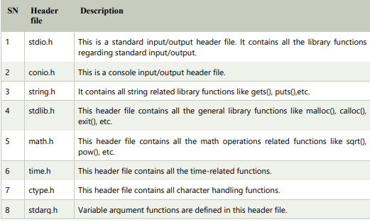
C Library Functions

Slide 77
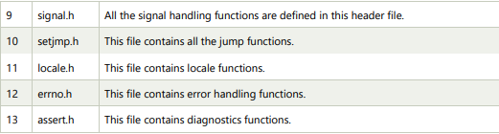

Slide 78
Call by value in C
In call by value method, the value of the actual parameters is copied into the formal parameters. In other words, we can say that the value of the variable is used in the function call in the call by value method.
In call by value method, we can not modify the value of the actual parameter by the formal parameter.
In call by value, different memory is allocated for actual and formal parameters since the value of the actual parameter is copied into the formal parameter.
The actual parameter is the argument which is used in the function call whereas formal parameter is the argument which is used in the function definition.

Slide 79
Example
#include
void change(int num) {
printf("Before adding value inside function num=%d \n",num);
num=num+100;
printf("After adding value inside function num=%d \n", num); }
int main() {
int x=100;
printf("Before function call x=%d \n", x);
change(x);//passing value in function
printf("After function call x=%d \n", x);
return 0;
}
Output: Before function call x=100
Before adding value inside function num=100
After adding value inside function num=200
After function call x=100

Slide 80
Call by reference in C
In call by reference, the address of the variable is passed into the function call as the actual parameter.
The value of the actual parameters can be modified by changing the formal parameters since the address of the actual parameters is passed.
In call by reference, the memory allocation is similar for both formal parameters and actual parameters. All the operations in the function are performed on the value stored at the address of the actual parameters, and the modified value gets stored at the same address.

Slide 81
Example
#include
void change(int *num) {
printf("Before adding value inside function num=%d \n",*num);
(*num) += 100;
printf("After adding value inside function num=%d \n", *num); }
int main() {
int x=100;
printf("Before function call x=%d \n", x);
change(&x);//passing reference in function
printf("After function call x=%d \n", x);
return 0;}
Output Before function call x=100
Before adding value inside function num=100
After adding value inside function num=200
After function call x=200

Slide 82
RECURSION
C Language

Slide 83
Recursion is the process which comes into existence when a function calls a copy of itself to work on a smaller problem.
Any function which calls itself is called recursive function, and such function calls are called recursive calls.
Recursion involves several numbers of recursive calls.
Recursion cannot be applied to all the problem, but it is more useful for the tasks that can be defined in terms of similar subtasks.
For Example, recursion may be applied to sorting, searching, and traversal problems.

Slide 84
In the following example, recursion is used to calculate the factorial of a number.
#include
int fact (int);
int main() {
int n,f;
printf("Enter the number whose factorial you want to calculate?");
scanf("%d",&n);
f = fact(n);
printf("factorial = %d",f); }
int fact(int n) {
if (n==0) {
return 0;}
else if ( n == 1) {
return 1; }
else{
return n*fact(n-1); } }
Output :Enter the number whose factorial you want to calculate?5
factorial = 120

Slide 85
Example
Let's see an example to find the nth term of the Fibonacci series.
#include
int fibonacci(int);
void main () {
int n,f;
printf("Enter the value of n?");
scanf("%d",&n);
f = fibonacci(n);
printf("%d",f); }
int fibonacci (int n) {
if (n==0) {
return 0; }
else if (n == 1) {
return 1;} .
else{
return fibonacci(n-1)+fibonacci(n-2);}}
Output :Enter the value of n?12
144

Slide 86
Memory allocation of Recursive method
Each recursive call creates a new copy of that method in the memory. Once some data is returned by the method, the copy is removed from the memory.
Since all the variables and other stuff declared inside function get stored in the stack, therefore a separate stack is maintained at each recursive call.
Once the value is returned from the corresponding function, the stack gets destroyed. Recursion involves so much complexity in resolving and tracking the values at each recursive call.
Therefore we need to maintain the stack and track the values of the variables defined in the stack.

Slide 87
Example:
int display (int n) {
if(n == 0)
return 0; // terminating condition
else {
printf("%d",n);
display(n-1); // recursive call
printf("%d",n);
}
}

Slide 88
ARRAYS
C Language

Slide 89
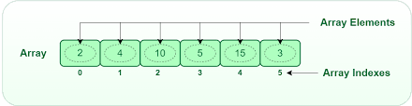
Introduction to Arrays :
Arrays are used to store multiple values in a single variable, instead of declaring separate variables for each value.
To create an array, define the data type (like int) and specify the name of the array followed by square brackets [].
To access an array element, refer to its index number.

Slide 90
Declaration of an array:
data_type array_name[array_size];
Eg: int numbers[5];
char characters[10];
Initialization of an array :
data_type array_name[array_size] = {value1, value2, ..., valueN};
Eg: int numbers[] = {1, 2, 3, 4, 5};
Accessing an array :
array_name[index]

Slide 91
At compile time initialization :
We can initialize the elements of arrays in the same way as the ordinary variables when they are declared. The general form of initialization of array is
Data type array name [size]={list of values};
eg: int number[5]={10, 18,99,77,66};
We can initialize values to the array elements like this also.
int number[3];
number[0]=40;
number[1]=50;
number[2]=60;

Slide 92
At run time initialization :
An array can be explicitly initialized at run time. This approach is usually applied for initializing large arrays. To read elements to an array, looping statement is used to change the index of the element, since all the elements will differ by its index only.
Ex: int ages[10], in;
for(in=0;in<10; in++)
{
scanf(“%d”, &ages[in]);
}

Slide 93
Length of array :
The sizeof operator is a compile-time unary operator that calculates the size of the variable and datatypes. The sizeof operator is primarily used for dynamic memory allocation but it can also be used to find the length of the array.
Sizeof(Array_name): It is an operator that returns the sixe of the entire array in bytes.
sizeof(Array_name[index]): It returns the size of a single element in the array in bytes.

Slide 94
Basic Problems
Index & printing specific elements of an Array - http://tinyurl.com/3p2zecv5
Displaying the count of elements - http://tinyurl.com/pkwn2rex
Changing the elements of an Array- http://tinyurl.com/44jm8cbn
Descending Order of elements - http://tinyurl.com/5n7f8774
Count positive and non-zero elements - http://tinyurl.com/w6dw8wvd

Slide 95
Traversing the elements of an array
#include <stdio.h>
int main() {
int length;
printf("Enter the length of the array: ");
scanf("%d", &length); // array length
int nums[length];
printf("Enter %d elements of the array:\n", length);
for (int i = 0; i < length; i++) {
printf("Element %d: ", i + 1); //getting each element from the user
scanf("%d", &nums[i]);
}
printf("The elements of the array are: ");
for (int i = 0; i < length; i++) {
printf("%d ", nums[i]); //displaying the elements
}
printf("\n");
return 0;
}

Slide 96
Reverse of an array - http://tinyurl.com/3tnam78h
#include <stdio.h>
int main() {
int length;
printf("Enter the length of the array: ");
scanf("%d", &length); // array length
int nums[length];
printf("Enter %d elements of the array:\n", length);
for (int i = 0; i < length; i++) {
printf("Element %d: ", i + 1); //getting each element from the user
scanf("%d", &nums[i]);
}printf("The elements of the array are: ");
for (int i = 0; i < length; i++) {
printf("%d ", nums[i]); //displaying the elements
}
printf("\n");
return 0;
}

Slide 97
Search for an element in array
#include <stdio.h>
int main() {
int nums[] = {5, 8, 2, 7, 1};
int length = sizeof(nums) / sizeof(nums[0]);
int target = 2, found = 0;
for (int i = 0; i < length; i++) {
if (nums[i] == target) {
found = 1;
break;
}
} if (found) printf("Element %d found in the array.\n", target);
else printf("Element %d not found in the array.\n", target);
return 0;
}

Slide 98
Check if array is sorted
#include <stdio.h>
int main() {
int n, sorted = 1;
printf("Enter the size of the array: ");
scanf("%d", &n);
int arr[n];
printf("Enter %d elements:\n", n);
for (int i = 0; i < n; i++) {
scanf("%d", &arr[i]); }
for (int i = 1; i < n; i++) {
if (arr[i] < arr[i - 1]) {
sorted = 0;
break;
}
} if (sorted) printf("Array is sorted in ascending order.\n");
else printf("Array is not sorted in ascending order.\n");
return 0;
}

Slide 99
Count of negative, positive and zeroes
#include <stdio.h>
int main() {
int n positive = 0, negative = 0, zero = 0;
printf("Enter the size of the array: ");
scanf("%d", &n);
int arr[n];
printf("Enter %d elements:\n", n);
for (int i = 0; i < n; i++) {
scanf("%d", &arr[i]);
}
for (int i = 0; i < n; i++) {
if (arr[i] > 0) positive++;
else if (arr[i] < 0) negative++;
else zero++;
} printf("Positive: %d, Negative: %d, Zero: %d\n", positive, negative, zero);
return 0;
}

Slide 100
Sum of elements - http://tinyurl.com/yc8y66p3
#include <stdio.h>
int main() {
int length;
printf("Enter the length of the array: ");
scanf("%d", &length); // array length
int nums[length];
printf("Enter %d elements of the array:\n", length);
for (int i = 0; i < length; i++) {
printf("Element %d: ", i + 1); //getting each element from the user
scanf("%d", &nums[i]);
} int sum = 0;
for (int i = 0; i < length; i++) {
sum += nums[i]; //calculating the sum
} printf("The sum of elements in the array is: %d\n", sum);
return 0;
}

Slide 101
Finding the largest element - http://tinyurl.com/2zjw6zyh
#include <stdio.h>
int main() {
int nums[] = {5, 8, 2, 7, 1};
int length = sizeof(nums) / sizeof(nums[0]);
int max = nums[0];
for (int i = 1; i < length; i++) {
if (nums[i] > max) {
max = nums[i];
}
} printf("Largest element in the array: %d\n", max);
return 0;
}

Slide 102
Second largest element - http://tinyurl.com/95s37eh8
#include <stdio.h>
int main() {
int n;
printf("Enter the size of the array: ");
scanf("%d", &n);
if (n < 2) {
printf("Array should have at least two elements.\n");
return 0; }
int arr[n];
printf("Enter %d elements:\n", n);
for (int i = 0; i < n; i++) {
scanf("%d", &arr[i]);
}

Slide 103
Second largest element
int firstLargest = arr[0], secondLargest = arr[1];
for (int i = 2; i < n; i++) {
if (arr[i] > firstLargest) {
secondLargest = firstLargest;
firstLargest = arr[i];
} else if (arr[i] > secondLargest && arr[i] != firstLargest) {
secondLargest = arr[i];
}
} // Display the second largest element
printf("Second largest element: %d\n", secondLargest);
return 0;
}

Slide 104
Left rotation
#include <stdio.h>
void leftRotate(int arr[], int n, int d) {
int temp[d]; // Create a temporary array to store the rotated elements
for (int i = 0; i < d; i++) { // Copy the first d elements to the temporary array
temp[i] = arr[i];
}
for (int i = d; i < n; i++) {
arr[i - d] = arr[i]; // Shift the remaining elements to the left
}
for (int i = 0; i < d; i++) { //Copy back temporary array to end of the original array
arr[n - d + i] = temp[i];
}
}

Slide 105
Left rotation
int main() {
int n, d;
printf("Enter the size of the array: "); // Input: Size of the array
scanf("%d", &n);
int arr[n]; // Input: Elements of the array
printf("Enter %d elements:\n", n);
for (int i = 0; i < n; i++) {
scanf("%d", &arr[i]);
} // Input: Number of positions to rotate left
printf("Enter the number of positions to rotate left: ");
scanf("%d", &d); // Perform left rotation and print the rotated array
leftRotate(arr, n, d);
printf("Array after left rotation:\n");
for (int i = 0; i < n; i++) {
printf("%d ", arr[i]);
} return 0;
}

Slide 106
Problems
http://tinyurl.com/mvhd8x9y - Contains Duplicate
http://tinyurl.com/5n7c8tuc - Contains Duplicate II
http://tinyurl.com/3w4rcj37 - Find the Duplicate Number
http://tinyurl.com/rwj9yp4c - Arithmetic Progression
http://tinyurl.com/mshndu4k - Left Rotation
http://tinyurl.com/2w9ta85b - Penalty Shots
http://tinyurl.com/3jexjcsz - Non-Negative Product

Slide 107
Problems
http://tinyurl.com/3hmvjuzd - Simple Encoded Array
http://tinyurl.com/bdahxcsr - Decreasing Sequence
http://tinyurl.com/yc8ep8rk - Most Frequently Occurring Digit
http://tinyurl.com/yk5np3b3 - All array Problems
http://tinyurl.com/3dz3svzf - Sorting problems

Slide 108
Multi-dimensional Array :
A multi-dimensional array in C is an array with more than one dimension. Commonly used are two-dimensional arrays, which are like tables with rows and columns. The syntax for declaring and initializing a two-dimensional array in c is as follows :
Syntax
data_type array_name[row_size][column_size];
Syntax for initialization of array
data_type array_name[row_size][column_size] = {
{value11, value12, ..., value1N},
{value21, value22, ..., value2N},
// ...,
{valueM1, valueM2, ..., valueMN}
};

Slide 109
Example for two-dimensional array
#include <stdio.h>
int main() { // Declaration and initialization of a 2D integer array
int matrix[3][4] = {
{1, 2, 3, 4},
{5, 6, 7, 8},
{9, 10, 11, 12}
}; // Accessing and printing array elements
for (int i = 0; i < 3; ++i) {
for (int j = 0; j < 4; ++j) {
printf("Element at (%d, %d): %d\n", i, j, matrix[i][j]);
}
}
return 0;
}

Slide 110
Creating and displaying matrix
printf("\nMatrix A: \n");
for (i = 0; i < 3; i++) {
for (j = 0; j < 3; j++) {
printf("%d ", a[i][j]);
}
printf("\n");
}
printf("\nMatrix B: \n");
for (i = 0; i < 3; i++) {
for (j = 0; j < 3; j++) {
printf("%d ", b[i][j]);
}
printf("\n");
}
return 0;
}
#include <stdio.h>
int main() {
int a[3][3], b[3][3], i, j;
printf("Enter the elements of matrix A:\n");
for (i = 0; i < 3; i++) {
for (j = 0; j < 3; j++) {
scanf("%d", &a[i][j]);
}
}
printf("Enter the elements of matrix B:\n");
for (i = 0; i < 3; i++) {
for (j = 0; j < 3; j++) {
scanf("%d", &b[i][j]);
}
}

Slide 111
Addition of matrix
for (int i = 0; i < rows; i++) {
for (int j = 0; j < cols; j++) {
result[i][j] = matrix1[i][j] + matrix2[i][j];
}
} // Display the result matrix
printf("Resultant matrix after addition:\n");
for (int i = 0; i < rows; i++) {
for (int j = 0; j < cols; j++) {
printf("%d ", result[i][j]);
}
printf("\n");
}

Slide 112
Lower Triangular Matrix
for (i = 0; i < Max_Row; i++)
{
for (j = 0; j < Max_Column; j++)
{
if (i < j)
{
M[i][j] = 0;
}
}
} printf("The Lower Traingular Matrix is: \n");
for (i = 0; i < Max_Row; i++)
{
for (j = 0; j < Max_Column; j++)
{
printf("%d ", M[i][j]);
} printf("\n");
}

Slide 113
Multiplication of Matrices
#include<stdio.h>
int main()
{
int r1,r2,c1,c2;
printf("Enter number of rows for First Matrix:\n");
scanf("%d",&r1);
printf("Enter number of columns for First Matrix:\n");
scanf("%d",&c1);
printf("Enter number of rows for Second Matrix:\n");
scanf("%d",&r2);
printf("Enter number of columns for Second Matrix:\n");
scanf("%d",&c2);
if(c1!=r2)
{
printf("Matrices Can't be multiplied together");
}

Slide 114
else
{
int m1[r1][c1],m2[r2][c2];
printf("Enter first matrix elements \n");
for(int i=0;i<r1;i++)
{
for(int j=0;j<c1;j++)
{
scanf("%d",&m1[i][j]);
}
}
printf("Enter Second matrix elements\n");
for(int i=0;i<r2;i++)
{
for(int j=0;j<c2;j++)
{
scanf("%d",&m2[i][j]);
}
}

Slide 115
int mul[r1][c2];
for(int i=0;i<r1;i++)
{
for(int j=0;j<c2;j++)
{
mul[i][j]=0; // Multiplying i’th row with j’th column
for(int k=0;k<c1;k++)
{
mul[i][j]+=m1[i][k]*m2[k][j];
}
}
}
printf("Multiplied matrix\n");
for(int i=0;i<r1;i++)
{
for(int j=0;j<c2;j++)
{
printf("%d\t",mul[i][j]);
} printf("\n"); } }
return 0;
}

Slide 116
Transpose
for (int i = 0; i < rows; i++) {
for (int j = 0; j < cols; j++) {
transpose[j][i] = matrix[i][j];
}
} printf("Transpose of the matrix:\n");
for (int i = 0; i < cols; i++) {
for (int j = 0; j < rows; j++) {
printf("%d ", transpose[i][j]);
} printf("\n");
} return 0;
}
#include <stdio.h>
int main() {
int rows, cols;
printf("Enter the number of rows and columns for the matrix: ");
scanf("%d %d", &rows, &cols);
int matrix[rows][cols], transpose[cols][rows];
printf("Enter elements of the matrix:\n");
for (int i = 0; i < rows; i++) {
for (int j = 0; j < cols; j++) {
scanf("%d", &matrix[i][j]);
} }

Slide 117
Practice problems
Sort the given array in descending order.
Create a duplicate array.
Find sum of diagonal elements of a matrix.
Compare two matrices.
Sum each row and column of matrix.
Sum of even numbers and sum of odd numbers of a matrix.
Check whether two matrices are equal or not.
Find the transpose of a matrix.
Find the determinant of a matrix.
Display lower triangular matrix.
Solve a system of linear equations using matrices.
To find the inverse of a matrix.

Slide 118
STRINGS
C Language

Slide 119
CONTENTS
Overview of Strings
Declaring and Initializing Strings
String Input and Output
String Functions

Slide 120

Overview of Strings
A string in C is a sequence of characters. These characters are stored in consecutive memory locations.
Unlike some other programming languages that have a dedicated string data type, C represents strings as arrays of characters.
Strings in C are null-terminated, meaning they are followed by a special character called the null character ('\0').
Arrays of Characters:
In C, strings are implemented as arrays of characters. Each character in the string is stored in a separate element of the array.

Slide 121
String Declaration and Initialization
Strings in C can be declared using the char data type. The declaration syntax involves specifying an array of characters.
Ex: char str[] = "Hello";
In this declaration, the array size is automatically determined based on the length of the string literal.
Strings can be initialized either at the time of declaration or later using an assignment.
Ex: char greeting[6] = {'H', 'e', 'l', 'l', 'o', '\0'};
Here, an array named greeting is declared and initialized with the characters 'H', 'e', 'l', 'l', 'o', and the null character '\0'.
The size of the array is explicitly specified (6), which accounts for the characters and the null terminator.

Slide 122
String Input and Output
Input using scanf:
The scanf function in C is commonly used to read input from the standard input stream (keyboard).
When reading strings, %s is used as the format specifier.
Example: scanf("%s", str);
However, using %s with scanf can lead to buffer overflow issues. scanf reads characters until it encounters whitespace, and it doesn't check the size of the destination buffer.

Slide 123
Output using printf:
The printf function is used for formatted output in C.
To print a string, the format specifier %s is used.
Ex: printf("String: %s", str);
This prints the content of the string variable str to the standard output.

Slide 124
String Functions in C
The <string.h> library in C provides a set of standard string manipulation functions that can be used to perform common operations on strings.
These functions are essential for tasks such as determining the length of a string, copying, concatenating, and comparing strings.
strlen() - Computes the length of a string.
Usage: size_t strlen(const char *str);
Ex: int length = strlen("Hello"); (length will be 5)
strcpy() - Copies the contents of one string to another.
Usage: char *strcpy(char *dest, const char *src);
Ex: char destination[20]; strcpy(destination, "Copy this");

Slide 125
strcat() - Concatenates (appends) one string to the end of another.
Usage: char *strcat(char *dest, const char *src);
Ex: char str1[20] = "Hello"; char str2[] = ", World!"; strcat(str1, str2);
strcmp() - Compares two strings lexicographically.
Usage: int strcmp(const char *str1, const char *str2);
Ex: int result = strcmp("abc", "abd"); (result will be negative)
strncpy() and strncat():
These are similar to strcpy and strcat but allow you to specify the number of characters to copy or concatenate, providing a level of control to avoid buffer overflow.

Slide 126
Length of the String
#include <stdio.h>
#include <string.h>
int main() {
char str[] = "Hello, World!";
int length = strlen(str);
printf("Length of the string: %d\n", length);
return 0;
}

Slide 127
Changing Characters
#include <stdio.h>
int main() {
char str[] = "Hello";
str[0] = 'h';
printf("Modified string: %s\n", str);
return 0;
}

Slide 128
Reverse a String
#include<stdio.h>
#include<string.h>
int main()
{
char str[20];
printf("Enter String: ");
gets(str);
printf("Entered string is: %s\n",str);
int start=0,end=strlen(str)-1;
while(start<end)
{
char temp=str[start];
str[start]=str[end];
str[end]=temp;
start++;
end--;
}
printf("Reversed string is: %s",str);
return 0;
}

Slide 129
String Palindrome
Input: String = “ABEEBA”
Output: ABEEBA is a Palindrome

Slide 130
#include <stdio.h>
#include <string.h>
int isPalindrome(char str[]) {
int left = 0;
int right = strlen(str) - 1;
while (left < right) {
if (str[left] != str[right]) {
return 0;
}
left++;
right--;
}
return 1;
int main() {
char str[100];
printf("Enter a string: ");
gets(str);
if (isPalindrome(str)) {
printf("The entered string is a palindrome.\n");
} else {
printf("The entered string is not a palindrome.\n");
}
return 0;
}

Slide 131
C Programs on String Operations
Input:
Enter the first string: “Hello”
Enter the second string: “, World!”
Output:
Concatenated string = Hello, World!

Slide 132
#include <stdio.h>
#include <string.h>
int main() {
char str1[20] = "Hello";
char str2[] = ", World!";
strcat(str1, str2);
printf("Concatenated string: %s\n", str1);
return 0;
}

Slide 133
Anagram Program in C
Anagram Program in C: Two strings are said to be anagrams if they satisfy two conditions, the length of both strings must be equal to each other and second the strings must have the same set of characters.
Example 1:
First String = “hectare” and Second String = “teacher”
Case 1:
Lengths must be equal to each other.
length of “hectare” = 7
length of “teacher” = 7
Case 1 passed.
Case 2:
Set of characters in
hectare {‘h’ , ’e’ , ’c’ , ’t’ , ’a’ , ’r’ , ’e’}
teacher {‘t’ , ’e’ , ’a’ , ’c’ , ’h’ , ’e’, ’r’}
Every character from the first string has a similar character to it in the other string. Case 2 passed.
”teacher” and ”hectare” are anagrams.

Slide 134
#include <stdio.h>
#include <string.h>
int areAnagrams(const char *str1, const char *str2) {
int len1 = strlen(str1);
int len2 = strlen(str2);
if (len1 != len2) {
return 0;
}
int count1[256] = {0};
int count2[256] = {0};
for (int i = 0; i < len1; i++) {
count1[(int)str1[i]]++;
}
for (int i = 0; i < len2; i++) {
count2[(int)str2[i]]++;
}
for (int i = 0; i < 256; i++) {
if (count1[i] != count2[i]) {
return 0; // Not anagrams
}
}
return 1;
}
int main() {
const char *word1 = "hectare";
const char *word2 = "teacher";
if (areAnagrams(word1, word2)) {
printf("%s and %s are anagrams.\n", word1, word2);
} else {
printf("%s and %s are not anagrams.\n", word1, word2);
}
return 0;
}

Slide 135
Insert Character/Word in Any Desired Location in a String
https://www.sanfoundry.com/c-program-insert-word-desired-location/
Delete All Repeated Words in String
https://www.sanfoundry.com/c-program-delete-repeated-words-string/
Remove Given Word from a String
https://www.sanfoundry.com/c-program-remove-word-from-string/
Read a String and Find the Sum of all Digits in the String
https://www.sanfoundry.com/c-program-sum-all-digits-string/
Find the Most and Least Repeated Character in the String https://www.sanfoundry.com/c-program-most-least-character-string/
Count Binary Substrings
https://leetcode.com/problems/count-binary-substrings/description/
Valid Palindrome
https://leetcode.com/problems/valid-palindrome/description/

Slide 136
Word Pattern
https://leetcode.com/problems/word-pattern/description/
Return second word in Uppercase
https://slaystudy.com/c-program-to-return-second-word-of-a-string-in-uppercase/
Highest Frequency Character in a String
https://www.sanfoundry.com/c-program-highest-frequency-string/
Practice - http://tinyurl.com/5ya4pxh3
Strings - http://tinyurl.com/bdfz673c

Slide 137

THANKS
FOR
LISTENING

